Slide 1

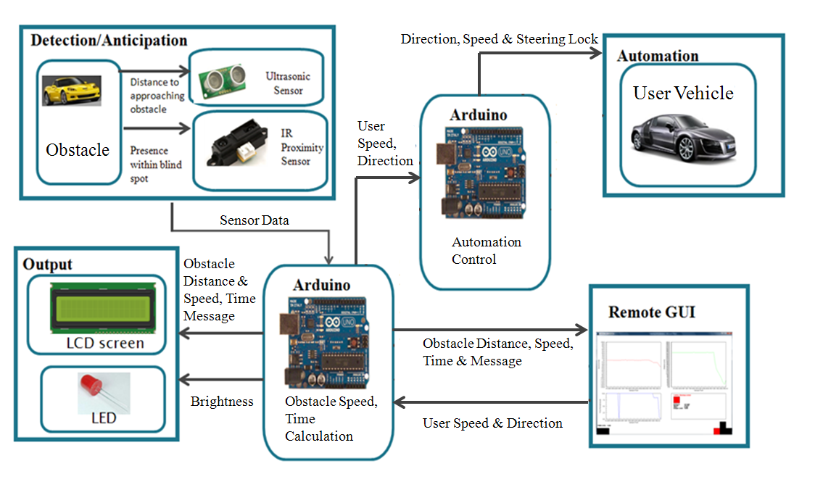
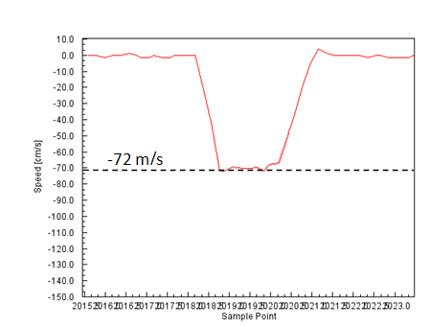
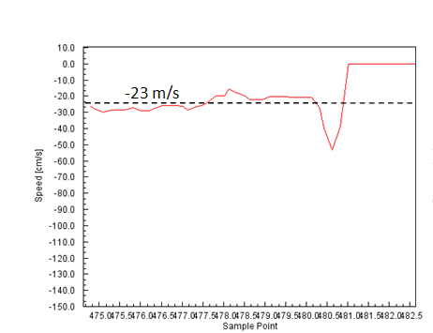
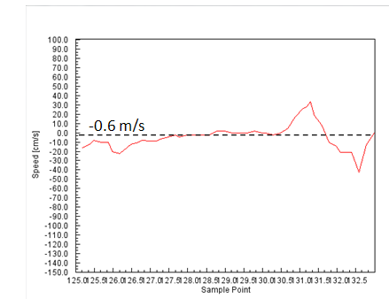
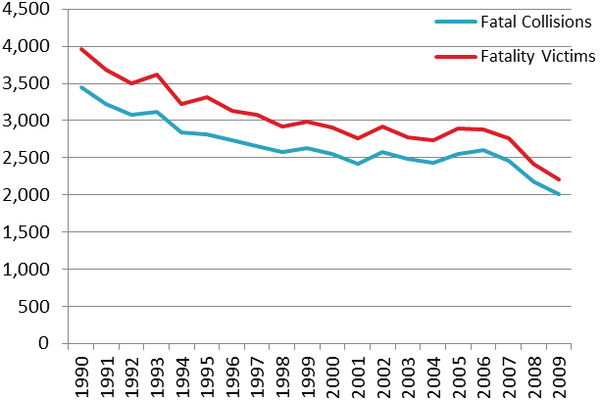
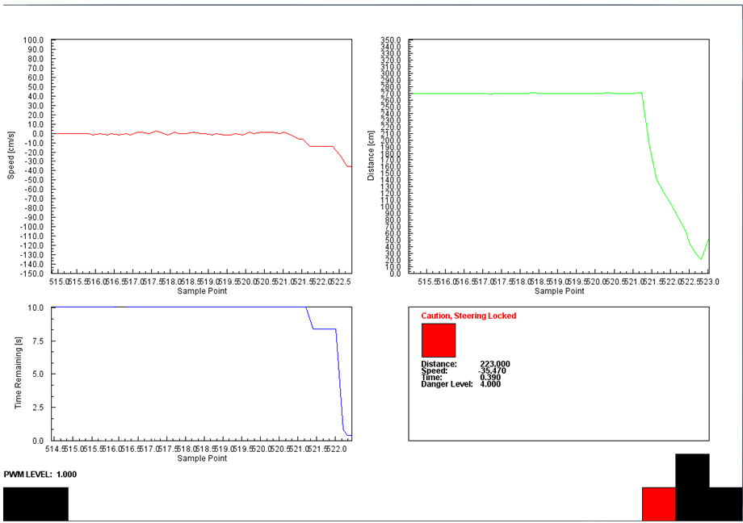
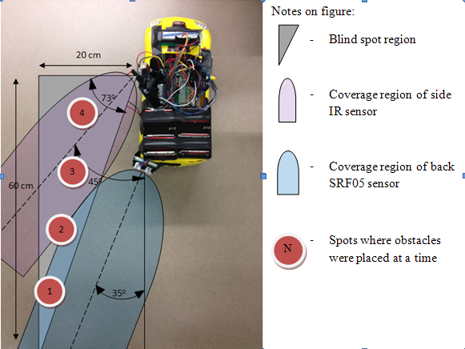
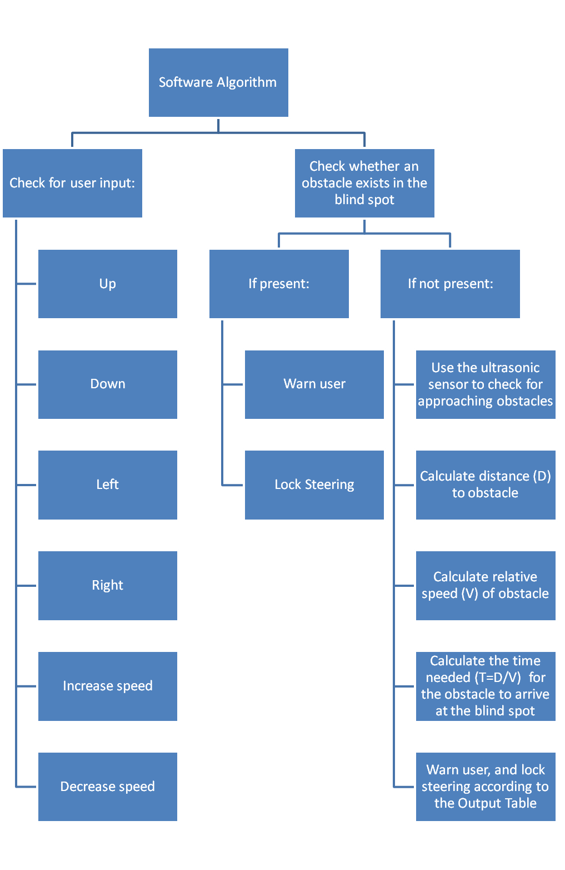
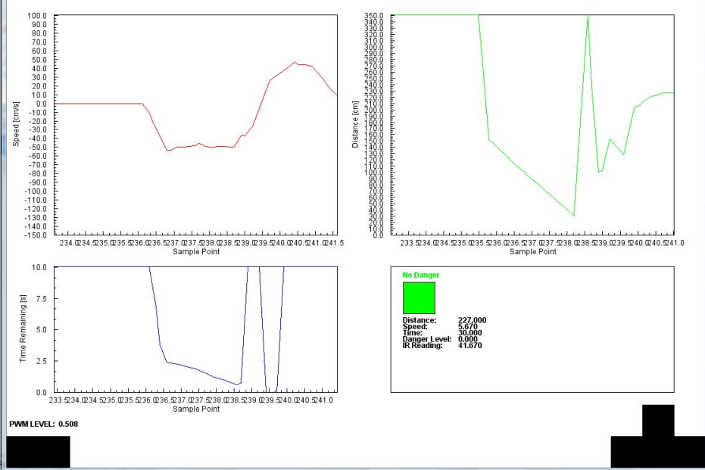
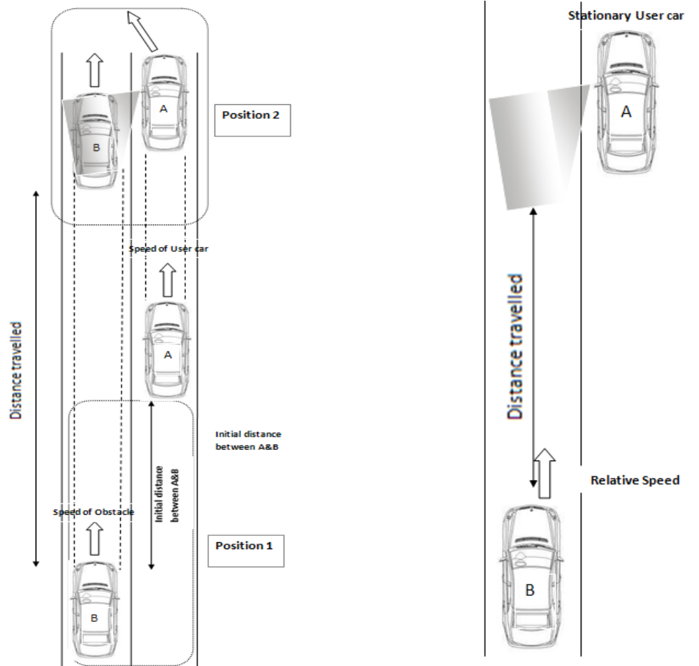
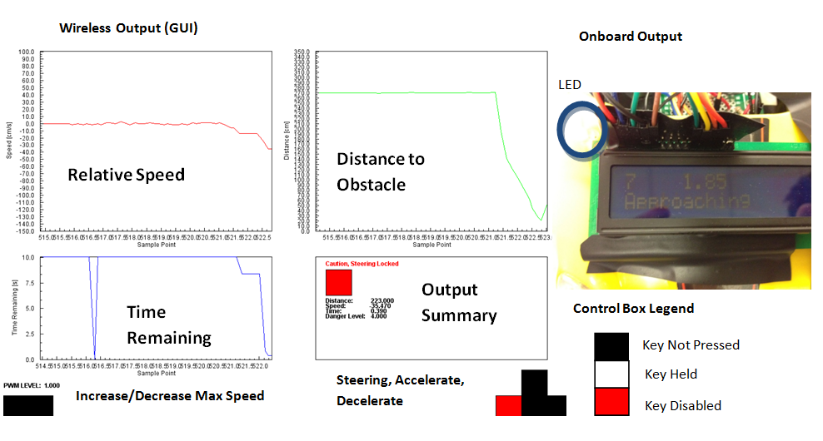
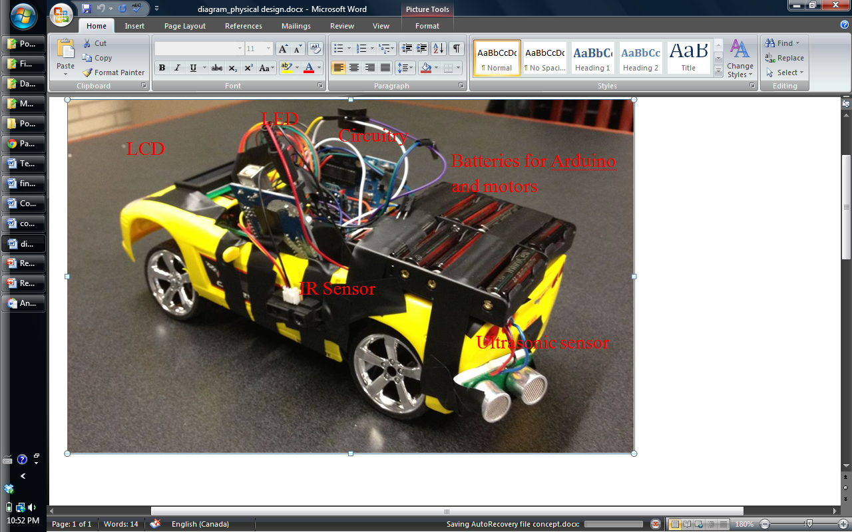
Vehicle Blind Spot Assist # 2011317
Hani Hadidi, Valikhan Kuparov, Tanzim Mokammel
Department of Electrical and Computer Engineering
University of Toronto
Motivation
Accident during lane changes are common due to driver’s not checking their Blind Spots
Companies such as BMW, Volvo etc have implemented blind spot assist devices on their models, however, universal devices are not widely available
Accident rates are decreasing as safety technology becomes more of a concern, but there’s room for improvement
Test Results
System Level Overview
Speed Tests
Distance Tests
 | Measured Relative speed, (v_{obstacle} – v_{user}), cm/s | Calculated Relative Speeds, cm/s | % Error
User vehicle PWM = 41% | 105.86 – 30.08 = 75.78 | 72.00 | 5.20
User vehicle PWM=51% | 105.86 – 81.72 = 24.14 | 23.00 | 4.90
User vehicle PWM=61% | 105.86 – 106.2 = -0.60 | -0.6 | 0.00
Ultrasonic
1
Actual distance (cm) | Test Result (cm) | Error, %
5 | 5 | 0.00
1 | 101 | 1.00
2 | 201 | 0.50
3 | 300 | 0.00
2
3
Infrared
2
3
Actual Distance (cm) | Test Result | Error, %
7.00 | 7.20 | 2.70
12.00 | 12.08 | 0.60
20.00 | 20.26 | 1.30
1
Steering Lock Test
Blind Spot Coverage Test
[1]
Figure 5: Fatal Collisions and Fatality Victims (1990-2009)
Project Goal
Assist in accident prevention through a device that will help users identify and anticipate obstacles in their vehicle’s blind spot
Provide an additional level of accident prevention through the implementation of an automated steering lock feature based on relative danger levels
Software Algorithm
Danger Levels and Output Table
Situation | Sensor Involved | Time Left [s] | Danger Level | LCD Screen Output | LED Output | Steering Locked
No Danger | Primary | t > 15 | 0 | Distance to obstacle, “No Danger” | Off | N
Obstacle Approaching | Primary | 11 < t < 15 | 1 | Distance to obstacle, relative speed, “Obstacle Approaching” | Brightness from 0% to 78%, depending on increasing distance | N
Obstacle Approaching | Primary | 6 < t < 11 | 2 |  |  | N
Obstacle Approaching | Primary | 3 < t < 6 | 3 |  |  | N
Obstacle Very Near | Primary | t < 3 | 4 | Distance to obstacle, relative speed, “Caution” | Fully On | N
Obstacle at Blind Spot | Secondary | t ≤ 0 | 5 | “Danger, Check Blind Spot” | Fully On | Y
System Level Test
System Level Test
Objective: | Device should accurately determine danger levels, and lock the steering accordingly
Date: | March 20th, 2012
Location: | 3rd floor hall, Bahen Center
Test Setup | Obstacle car and user car run with different known speeds Relative speed, distance and remaining time plots are observed For cases where time remaining was below the threshold, or an obstacle was already present in the blind spot, successful steering lock was observed
Feedback and Observations | Distance, Speed and time are calculated accurately; user is unable to collide into obstacle as the steering is locked when time remaining falls below the specified threshold
Proposed Concept
Conclusions and Future Work
The prototype meets the initial objectives within a scaled down environment
Improvements can be made to:
  Noise filtering algorithms
  Response time of the device
  Sensor placements
  Danger level look-up table
With advanced sensors, algorithm optimizations, and rigorous testing, the detection/anticipation component of the device can be implemented on real vehicles
Obtain distance between user car, and obstacle car
Calculate the relative speed between the two vehicles
Calculate how long the obstacle will take to go from position 1 to position 2 (time remaining)
Provide lane change advice to the user based on the time remaining value
  Lock the user vehicle’s steering if the time is too low
Output
Physical Design
Acknowledgements
Micah Stickel, Ross Gillett, Khoman Phang, Lawrence Chan, Mike Mehrniz
References
[1] Transport Canada, “Canadian Motor Vehicle Traffic Collision Statistics: 2009”, Internet: http://www.tc.gc.ca/eng/roadsafety/resources-researchstats-menu-847.htm, Jun. 01, 2011 [Sep.11, 2011].

